Slide 1
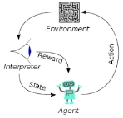
001 90 N 8th Street
Peter H. Chen

Slide 2
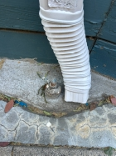
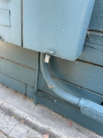
90 N 8th Street
Main Panel (above ground)
90 N 8th Street
Existing wires (Fourplex A, B, C,D) with public E
E
C
B
B
A
D
A
Around 15 feet
Around 10 feet
Building/Basement Wall
Sub-panel Panel (7 feet below ground)
Breakers: 30 A, 20 A, 15 A
E
E
D
C
C
B
B
B
A
A
D
A
Fire Line
Neutral Line

Slide 3
90 N 8th Street
Main Panel (above ground)
90 N 8th Street
Add new Ground Line (Fourplex A, B, C,D) with public E
E
C
B
B
A
D
A
Around 15 feet
Around 10 feet
Building/Basement Wall
Sub-panel Panel (7 feet below ground)
Breakers: 30 A, 20 A, 15 A
E
E
D
C
C
B
B
B
A
A
D
A
Fire Line
Neutral Line
Ground Wire (5 separate # 6 AWG wire with PVC covered)
5 Ground Bars

Slide 4
End

